Slide 1
Putting COVID Numbers and Vaccinations into Context
Department of Research
August 30, 2021

Slide 2
People often have a hard time grappling with large numbers. This exercise is intended to put COVID numbers into a more familiar (and hopefully meaningful) context.
Our Legend:
= one person
= 15 people
= 300 people

Slide 3
On average, how many people are killed by sharks in the US each year?
= 0.5 people (16 attacks each year, one fatality every other year)

Slide 4
On average, how many people die from lightning strikes in the US each year?

Slide 5
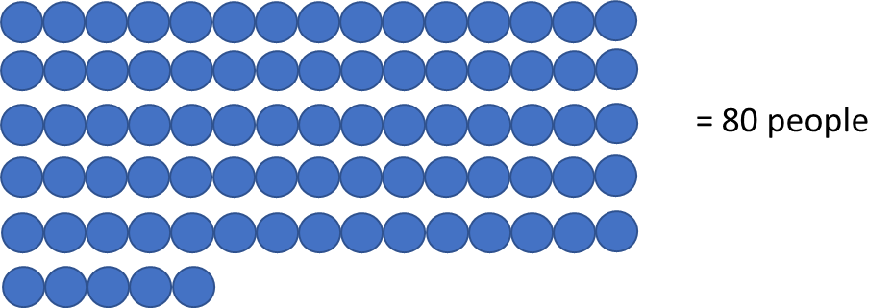
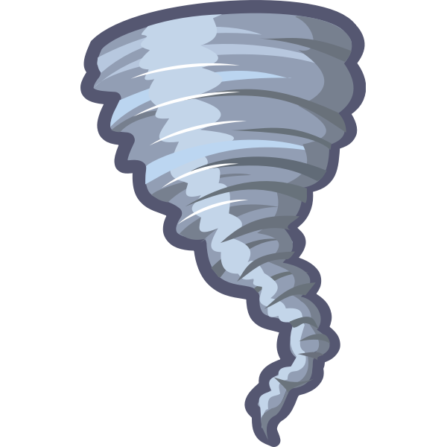
On average, how many people die from tornadoes in the US each year?

Slide 6
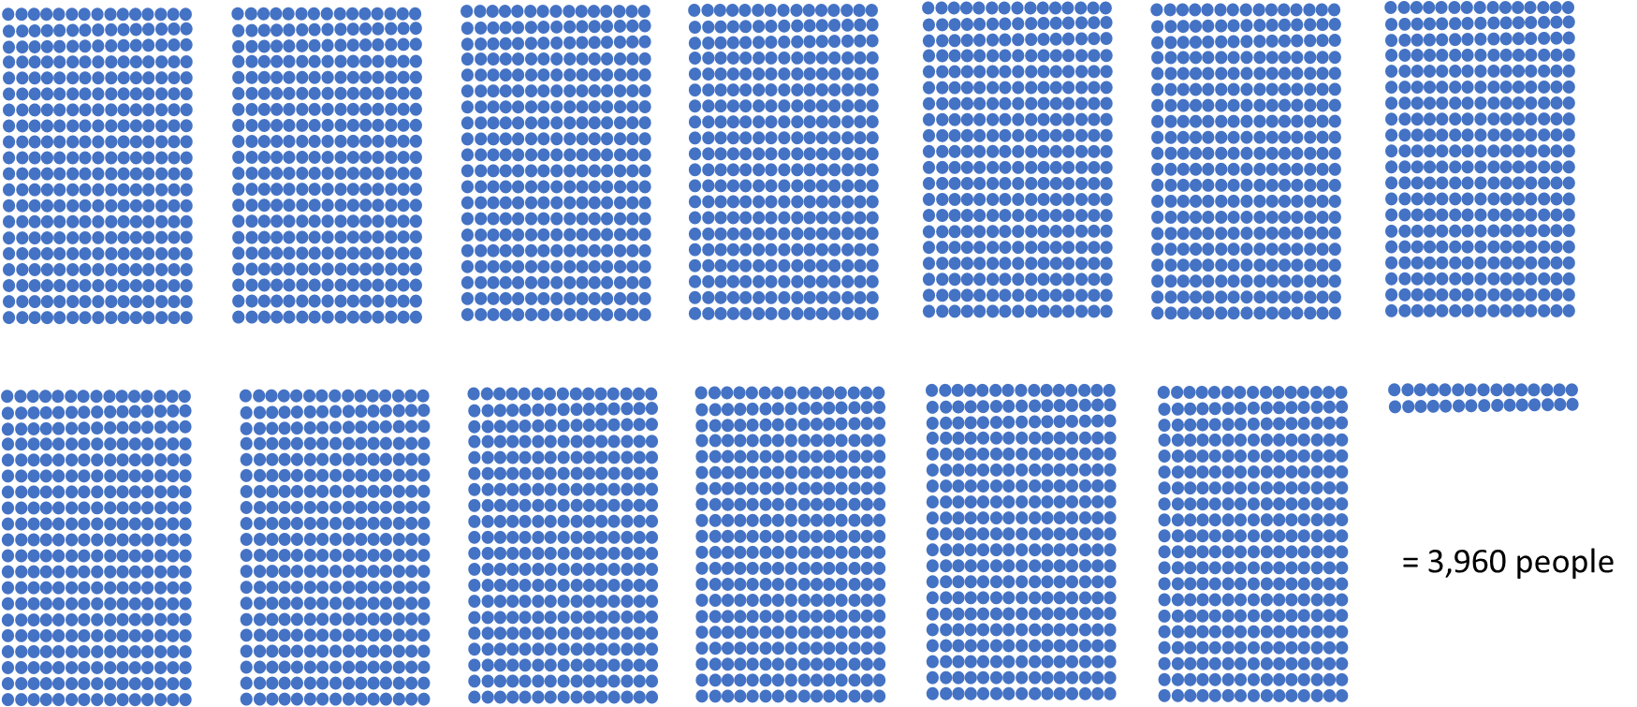
On average, how many people drown in the US each year?

Slide 7
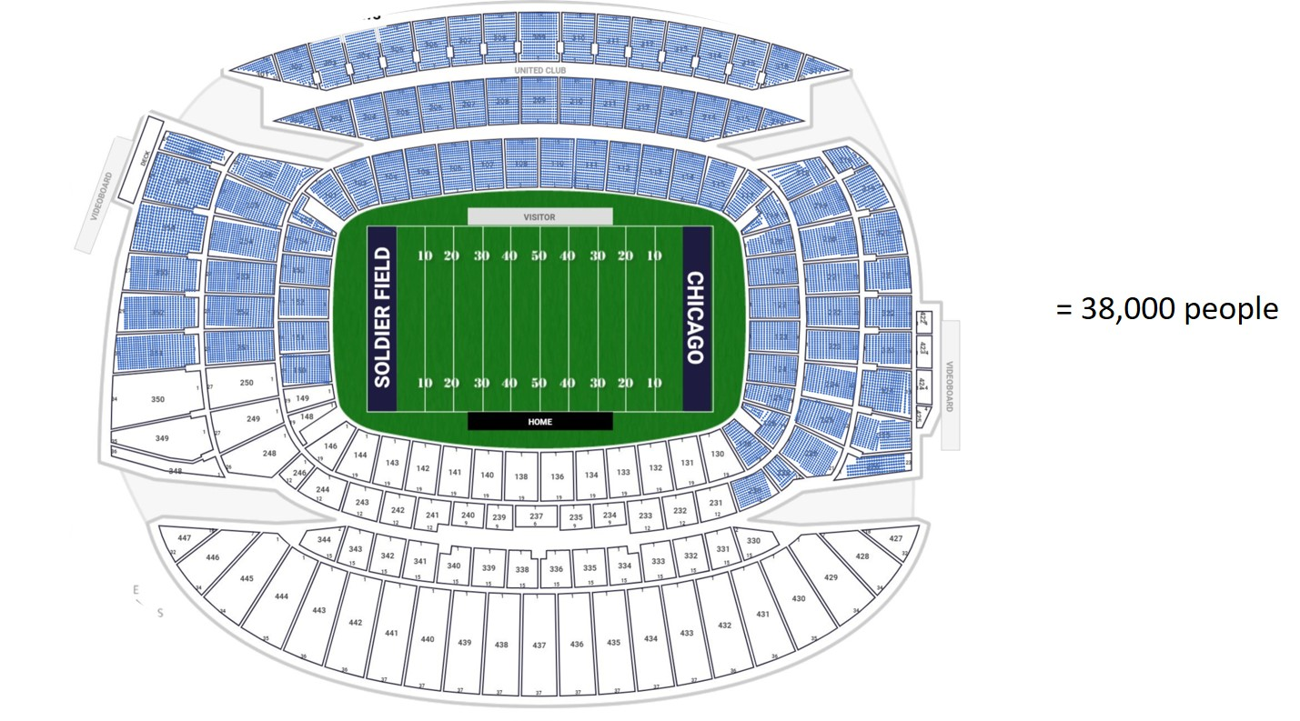
On average, how many traffic fatalities in the US each year?
Soldier Field Seating Chart from rateyourseats.com

Slide 8
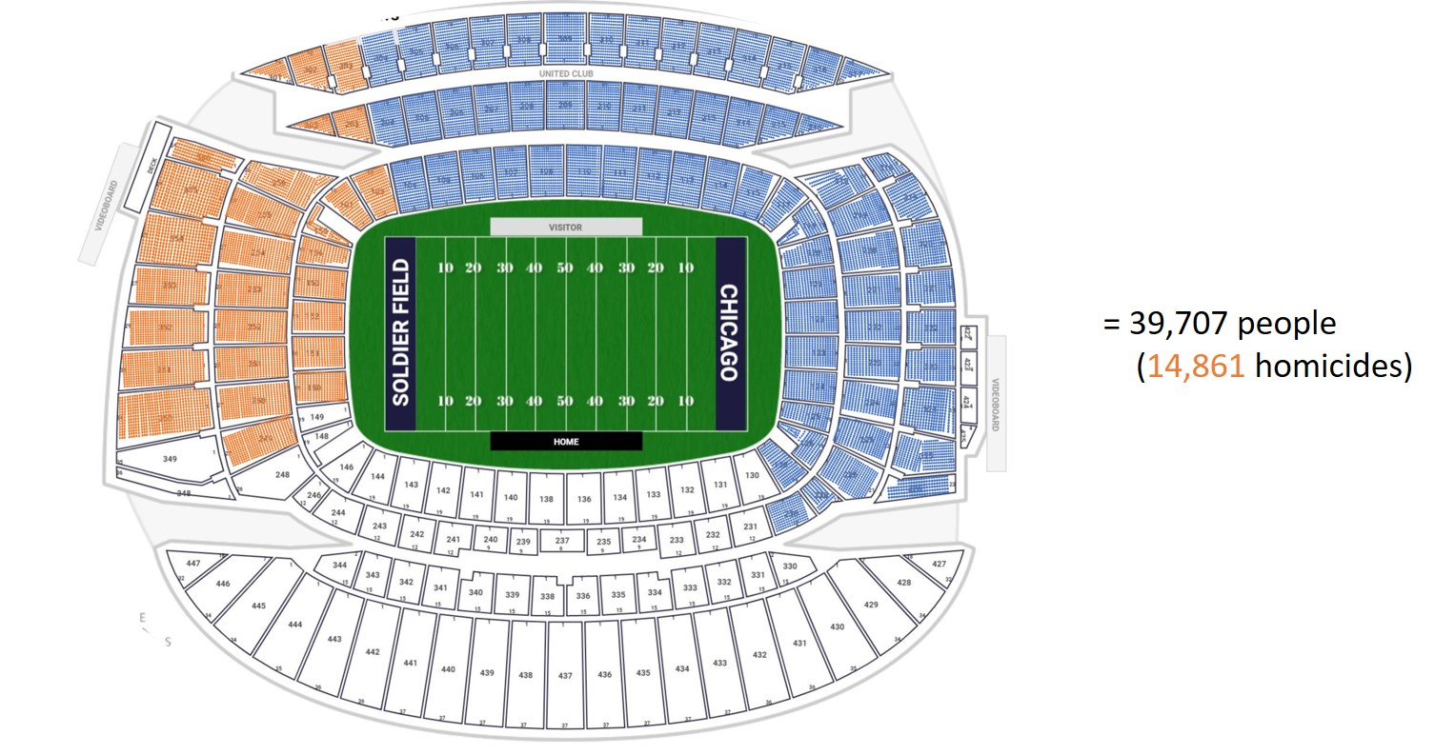
On average, how many gun deaths in the US each year?
Soldier Field Seating Chart from rateyourseats.com
This Photo by Unknown Author is licensed under CC Y-SA-NC

Slide 9
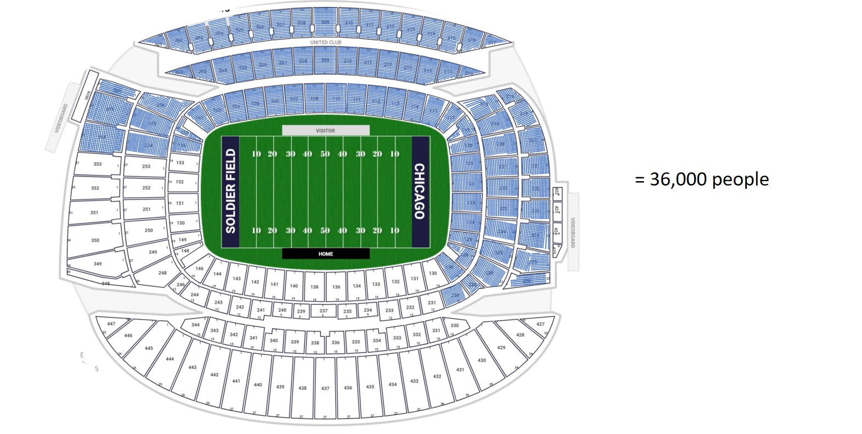
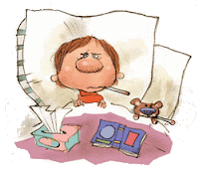
How many flu deaths in the US (average for last 10 years)?
Soldier Field Seating Chart from rateyourseats.com

Slide 10
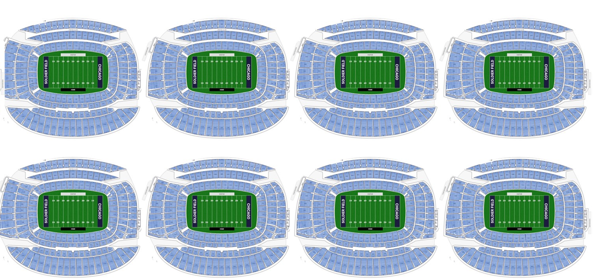
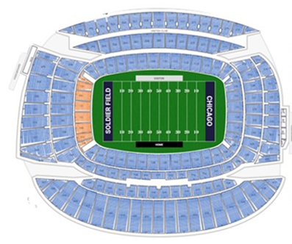
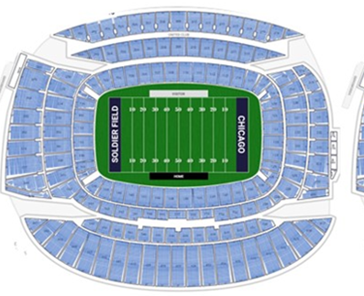
How many COVID deaths in the US (January 2020 – August 18, 2021)?
Deaths between February 1 and August 18, 2021 (After vaccines became available) = 181,000
= 614,531
Deaths among vaccinated people (1,400)
Deaths from January 2020 – February 2021 (Before vaccines became available) = 433,971

Slide 11
Do Vaccinations Work?
Approximately 170,000,000 Americans are vaccinated (leaving around 165,000,000 Americans who are unvaccinated). So, we are nearly split 50/50
If vaccinations have no effect, the death toll would look nearly identical between the vaccinated and unvaccinated
5,564 people died from COVID during the week of August 15-21
Here is the split we would expect, if vaccinations made no difference
Unvaccinated People
Vaccinated People

Slide 12
But here are the data we actually see!
There were 5,564 COVID deaths during the week of August 15th to August 21st
Depending upon the state you are in, the proportion of vaccinated people who die from COVID ranges from 0.1% to 5% of COVID all deaths.
And here are the 6 to 278 vaccinated people who died (you probably heard about breakthrough cases like these on the news)
Approximately 5,286 unvaccinated people died from COVID during the week of August 15-21
Unvaccinated People
Vaccinated People

Slide 13
Vaccinations Work!
We hope these illustrations are helpful. We think the data provides a pretty clear picture!
Be safe. Reduce your risk. Get your vaccine.
About The Joint Commission:
An independent, not-for-profit organization, The Joint Commission is the nation's oldest and largest standards-setting and accrediting body in health care. To earn and maintain The Gold Seal of Approval® from The Joint Commission, an organization undergoes an on-site survey by a Joint Commission survey team at least every three years (Laboratories are surveyed every two years).
The Joint Commission is governed by a 21-member Board of Commissioners that includes physicians, administrators, nurses, employers, quality experts, a consumer advocate and educators. The Joint Commission employs approximately 1,000 people in its surveyor force, at its central office in Oakbrook Terrace, Illinois, and at an office in Washington, D.C.

